Slide 1
ADA Update
Linda I. Singer
ADA Title II Coordinator
John Gover
ADA Review Team Leader
Maryland State Highway Administration

Slide 2
Recent Activities
SHA’s Sub-Recipient Program
2010 ADA Standards
Public Rights of Way
FHWA Guidance on Alterations

Slide 3
Sub-Recipients

Slide 4
Responsibilities
Local Government:
  ADA Coordinator
  Public notice of ADA/504 obligations
  Complaint/grievance procedure
  Self-evaluation
  Transition Plan
State Transportation Agency:
  Same as above for its own programs/services/policies etc.
  Ensure local entities receiving federal funds comply fully with ADA/504
  Ensure local entitles not receiving federal funds comply with ADA
  This includes having/updating transition plans

Slide 5
FHWA:
  Ensure recipients and sub-recipients of federal aid and state and local entities responsible for roadways and pedestrian facilities do not discriminate on basis of disability in any highway transportation program, activity, service or benefit provided to the general public
  FHWA does not have ADA oversight for projects outside PROW that do not use federal surface transportation funds, but does if such funds are used

Slide 6
Purpose of SHA’s Policy/Program
To ensure ADA compliance by state and local entities
To provide structure and expectations regarding compliance statewide
To assist local entities through an education-based approach
To assist local entities in avoiding increasingly harsh penalties for non-compliance
To ensure that federal funds to local entities are not impacted due to failure to comply with ADA
To resolve an FHWA notice to SHA of the need to fulfill its role as a “state transportation agency”

Slide 7
Administrative Obligations
ADA Title II Coordinator
Notice of Non-Discrimination and ADA Obligations
Grievance/Complaint Process and Form
Self-Assurance Notice
Self-Evaluation
Transition Plan

Slide 8
Technical Guidance
Training
  Administrative compliance
  Construction and Design
Technical Advice and Consultation
Design Review

Slide 9
Getting It Right
Field Verification
  If a sub-recipient has sidewalk on SHA roadways, SHA will field verify
  First level verification should be done by sub-recipient to verify what has been designed is being constructed properly on sub-recipient’s facilities
  SHA will spot check sub-recipient reports

Slide 10
Monitoring/Oversight
  SHA will require/assist in modifications of incorrect design/construction
  SHA will work with sub-recipient to develop necessary programmatic issues, i.e. planning and scheduling of work in transition plans
  SHA involvement in complaint resolution

Slide 11
2010 Standards

Slide 12
2010 Standards for Accessible Design Implementing ADA Title II
As result of the 2008 ADA Amendments Act, the US Access Board developed, and DOJ adopted, 2010 Standards for Accessible Design.
2010 Standards are harmonized the new guidelines with existing policies and guidelines, i.e., “paths of travel.”
When Does it Take Effect? NOW!
  Effective March 15, 2011
  Required for all new construction/alterations on March 15, 2012

Slide 13
Significant Changes
Element by Element Safe Harbor
Ticketing
Service Animals (When is a miniature horse a dog?)
Wheelchairs and Other Power-Driven Mobility Devices
Effective Communications
Residential Housing Offered for Sale to Individual Owners
Detention and Correctional Facilities

Slide 14
http://www.ada.gov/regs2010/2010ADAStandards/2010ADAstandards.htm
http://www.ada.gov/regs2010/2010ADAStandards/Guidance2010ADAstandards.htm

Slide 15
Public Rights of Way (PROW)

Slide 16
What about Public Rights of Way?
2010 Standards are directed mostly toward facilities, programs and services – not PROW.
There is a proposed rulemaking in process
  Guidelines are currently being developed,
    ETA is end of 2013
  Must be adopted by DOJ and DOT before it becomes final
  Shared Use Paths will be included

Slide 17
What Now?
According to the Access Board:
  The proposed PROWAG (PROW Accessibility Guidelines) are not final
  BUT, they are recognized by FHWA as a “Best Practice” in meeting ADA obligations for streets and Sidewalks
  http://www.access-board.gov/guidelines-and-standards/streets-sidewalks/public-rights-of-way/proposed-rights-of-way-guidelines

Slide 18
FHWA’s Newest Guidance on Alterations

Slide 19
New FHWA Guidance on Alterations
Provides clarification/broadens the definition of alteration and activities trigger ADA compliance.
When an alteration occurs to a roadway, curb ramps shall be provided where a pedestrian walkway crosses a curb.
Previously, resurfacing was defined as an alteration BUT…
Micro-surfacing was considered maintenance and therefore did not require ramps be brought up to current ADA standards.

Slide 20
SHA’s Response
Modify SHA’s Pavement Preservation Guide and Accessibility Policy and Guidelines to address FHWA’s change
All projects that contain these broader activities require placement of new curb ramps or reconstruction of existing ramps where pedestrian pathways cross a curb.
http://fhwa.dot.gov/civilrights/programs/doj_fhwa_ta.cfm

Slide 21
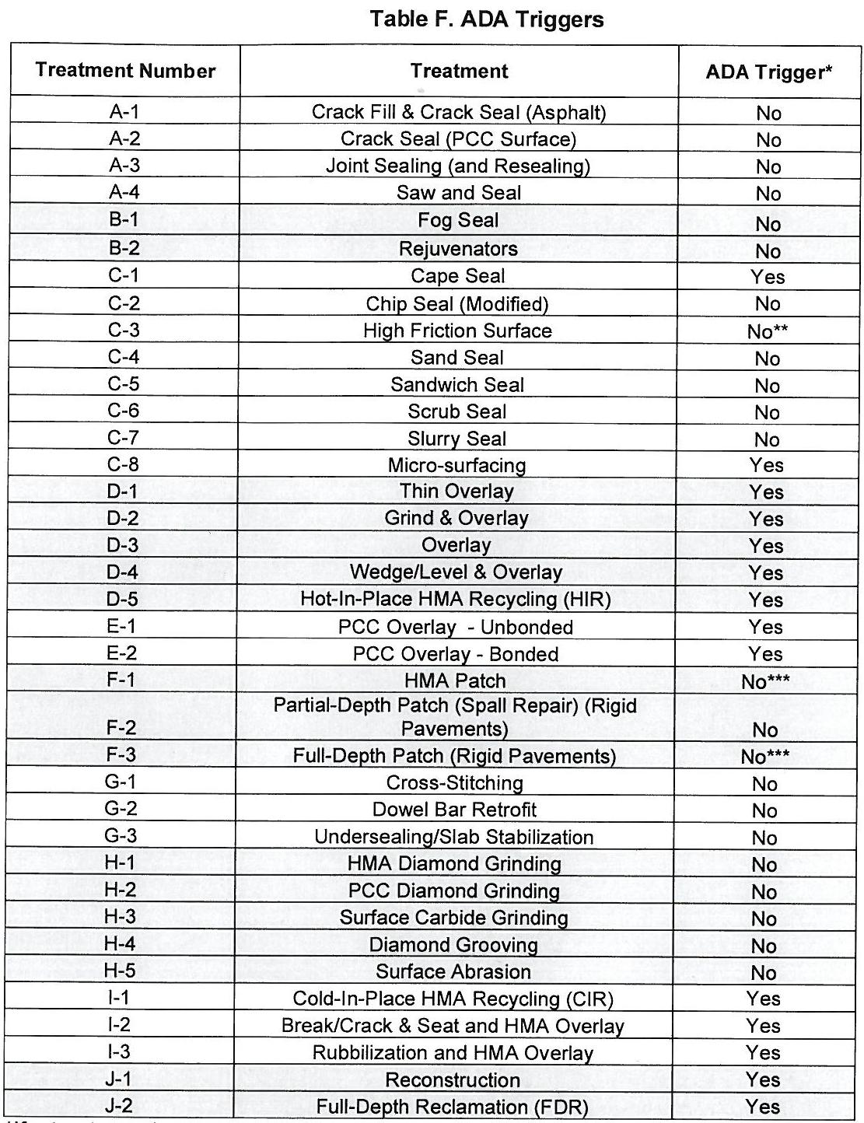
SHA’s Response

Slide 22
Contact Us:
Linda Singer
  410-545-0362
  lsinger@sha.state.md.us
John Gover
  410-545-8766
  wgover@sha.state.md.us

