Slide 1

County Engineers Association of Maryland Fall Conference 2013
What Tragedy has Taught Us about Professionalism, Ethics, Leadership and Public Safety
Ed Link
Department of Civil and Environmental Engineering
University of Maryland

Slide 2
Issue: Ethics in an Uncertain Future
Cannon 1: Engineers shall hold paramount the safety, health, and welfare of the public and shall strive to comply with the principles of sustainable development in the performance of their professional duties.
ASCE Code of Ethics

Slide 3
Things That Lead to Ethical Engineering
Licensing
Design Standards
Best Practice
Review
Inspection
Monitoring
Values

Slide 4
Things that Lead to Failure
Human Error
Compromise
Resources
Political Will
Scale
What We Don’t Know
What We Don’t Know We Don’t Know

Slide 5
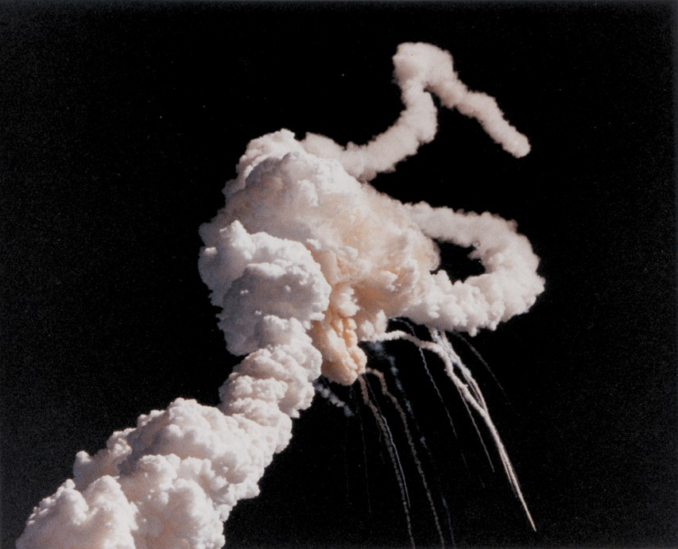
The Challenger Disaster
Abnormally cold launch forecast
‘O’ Rings not verified for cold condition
Program behind schedule; re-bid approaching
Engineers said ‘no’, but…..
1986 Launch
7 astronauts killed
Notes:
Thiokol's Bob Ebeling wrote the infamous 'Help!' memo in October 1985, informing everyone within his capabilities of the growing concerns about low temperature launches relating to the seals on the SRBs.
'We didn't think we were getting anyone's attention and we thought by using the subject 'Help!' would get them (Thiokol top level management) to read at least the first sentence of the memo,' said Ebeling.
'The entire Thiokol group recommended no launch,' remembered Ebeling, as they recommended a minimum launch temperature of 53F (11C). The expected rubber stamping of that recommendation was expected from NASA on the other end of the teleconference. However, they would be proven wrong.
'I thought it was a very poor briefing,' said Lovingood. 'To make such a huge statement on flight safety, it was an extremely poor briefing.' NASA engineers at MSFC started to pull apart Thiokol's data

Slide 6
Traditional Deterministic Design
Physically Possible &
Reasonably Probable
Physically
Unreasonable
Impossible
Unreasonably Rare
Improbable
Design Point
High Forces + Low Resistance + Factor of Safety
Dr. D.N.D. Hartford, BC Hydro

Slide 7
Emergence of Risk-Based Engineering
Risk = the expected value of an unwanted event which may or may not occur.
Portfolio of risks
Event
Event consequence
Rank-order
Event probability
The expected value is the product of its probability and some measure of its severity.

Slide 8
What Have We Learned Lately?
Hurricane Katrina 2005
Missouri/Mississippi River Flooding 2011
Super Storm Sandy 2012

Slide 9
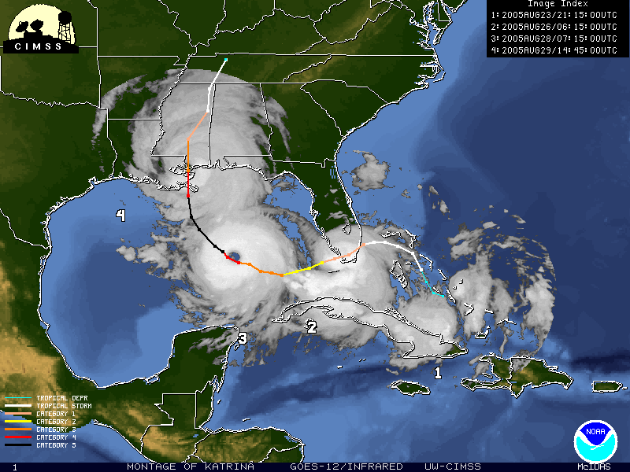

Slide 10
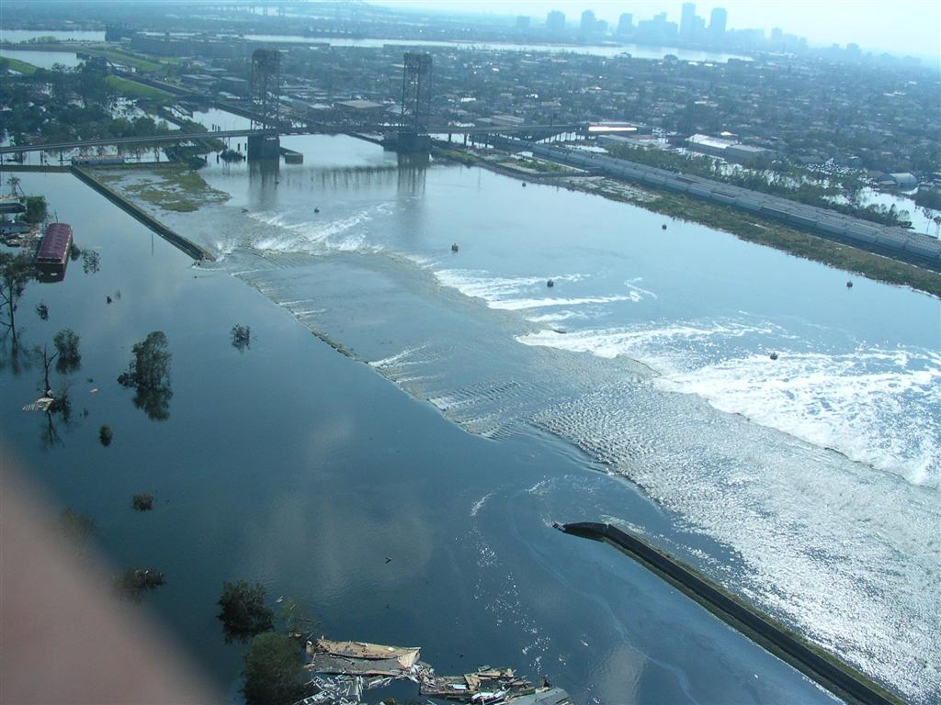
New Orleans, Katrina, August 29, 2005

Slide 11
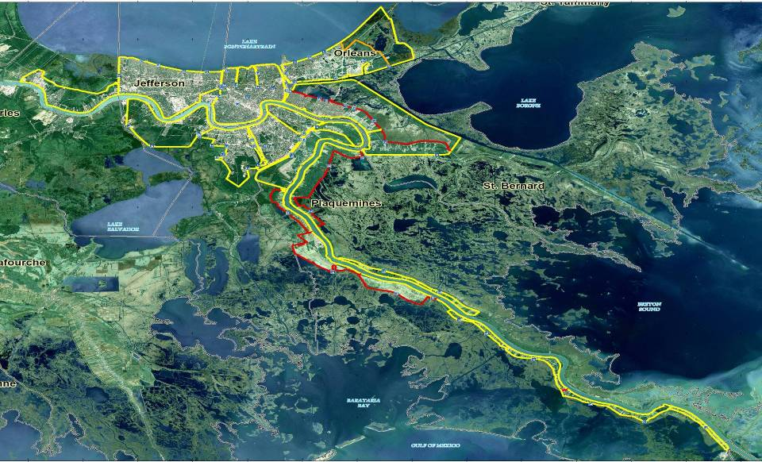
The hurricane protection system was constructed piecemeal under multiple authorities and remained incomplete when Katrina struck
Notes:
There were many part sto this system controlled ans built by many dififerent agencies
Seams were there and obviosu – post afacto
Levee- floodwall-gates, drainange not gamed as a while.
Whose sytem was it. Was it inspected as a system -no

Slide 12
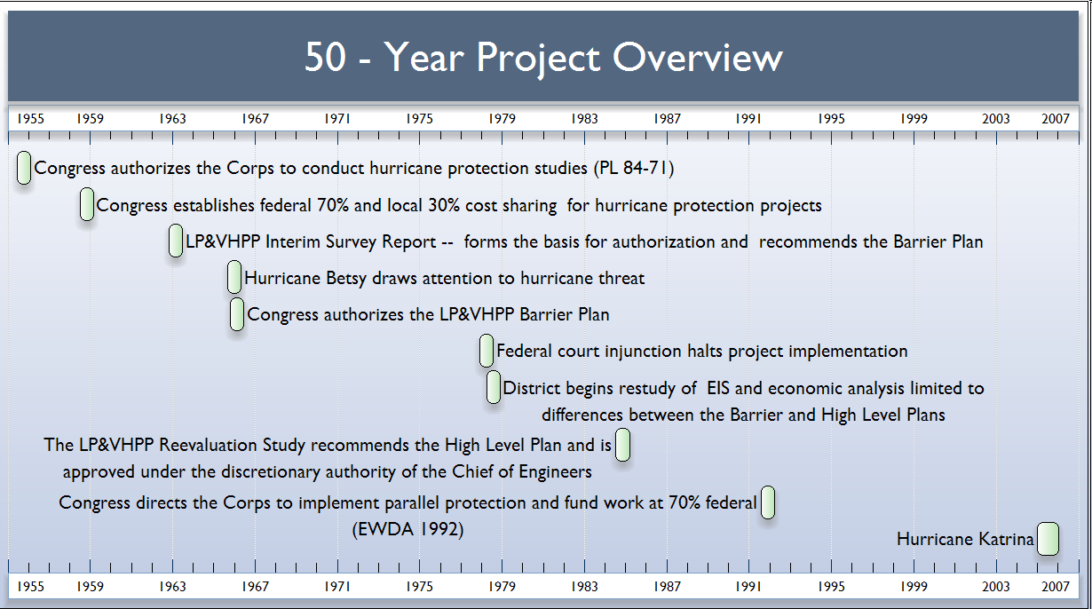
New Orleans Hurricane Protection System
Congress Authorizes Study
Congress Authorizes 70/30 cost sharing
Corps Recommends Barrier Plan
Hurricane Betsy
Congress Authorizes Barrier Plan
Federal Court halts project
Plan Reformulated
Corps Recommends high level plan
Congress Directs Parallel Protection Plan
Hurricane Katrina
Source: Hurricane Protection Decision Chronology Study

Slide 13
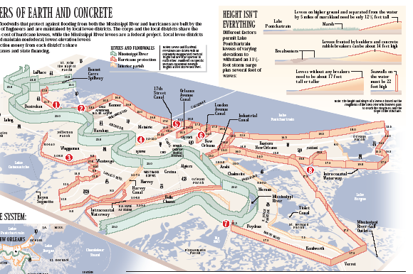
The Protection System in part increased risk by encouraging development in vulnerable areas

Slide 14
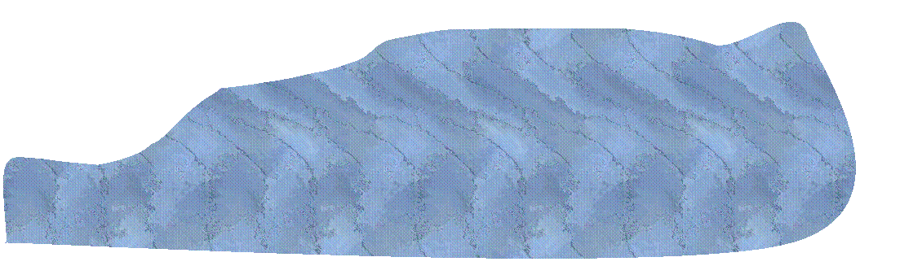
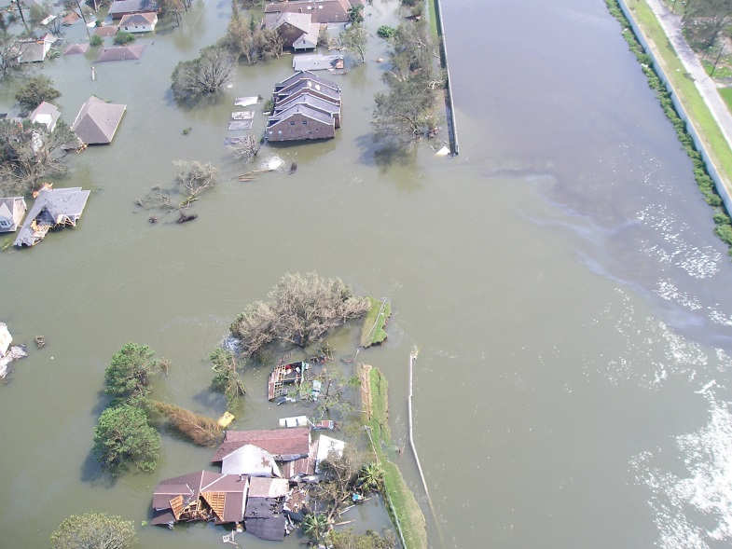





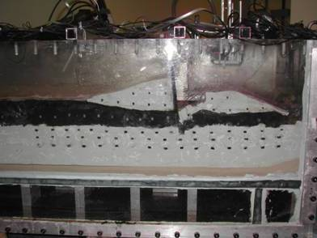
Design Criteria had not Considered Actual Failure Modes
Deflection and
Pressure
Failure and
Movement
C
L
Confirmation in Centrifuge
Displacement of wall and part of levee
Notes:
Rsational on next page

Slide 15
The Hazard Was Underestimated
Publication (Year) Period of Record Meteorological Parameter |  | USWB Tech Report #33 (1959) 1900-56 | NWS Tech Report #23 (1979) 1900-1975 | NOAA/NCDC Prelim Analysis (2006) 1900-2005
100-year Central Pressure Index (millibars) |  | 934.6 mb | 926.2 mb | 901.7 mb
Return Period for Hurricane Katrina intensity storm (905 mb) |  | 900 years | 285 years | 98 years

Slide 16
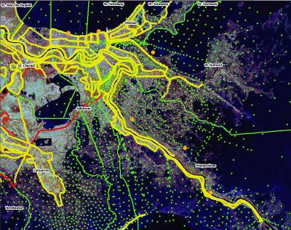
What Does History Suggest?
Aug 28, 2005 - Katrina surge = 1000+ year event
Sep 1, 2005 - Katrina surge = 100 + year event
1965 SPH = 12.4 ft,
1965 PMH = 15 ft,
Katrina = 20+ ft

Slide 17
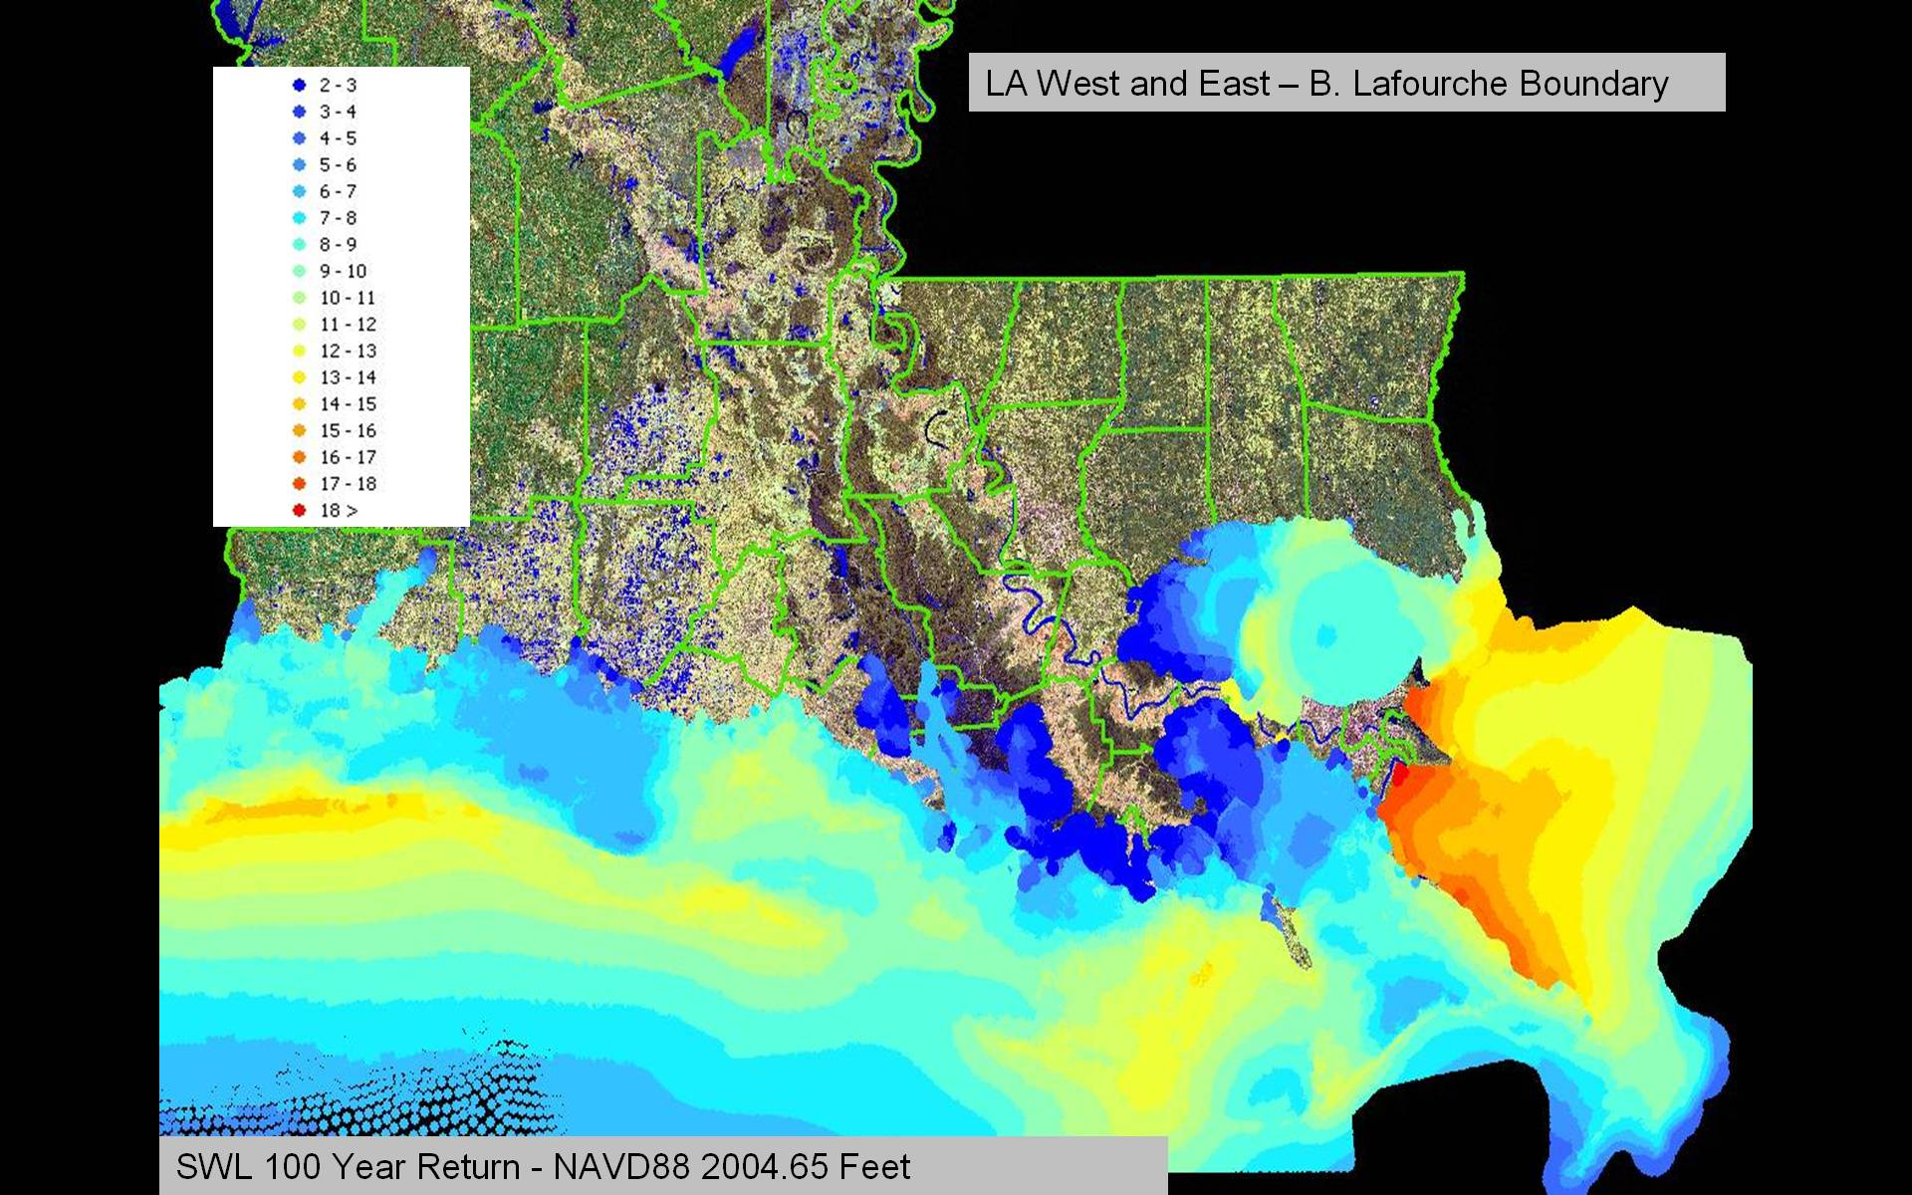
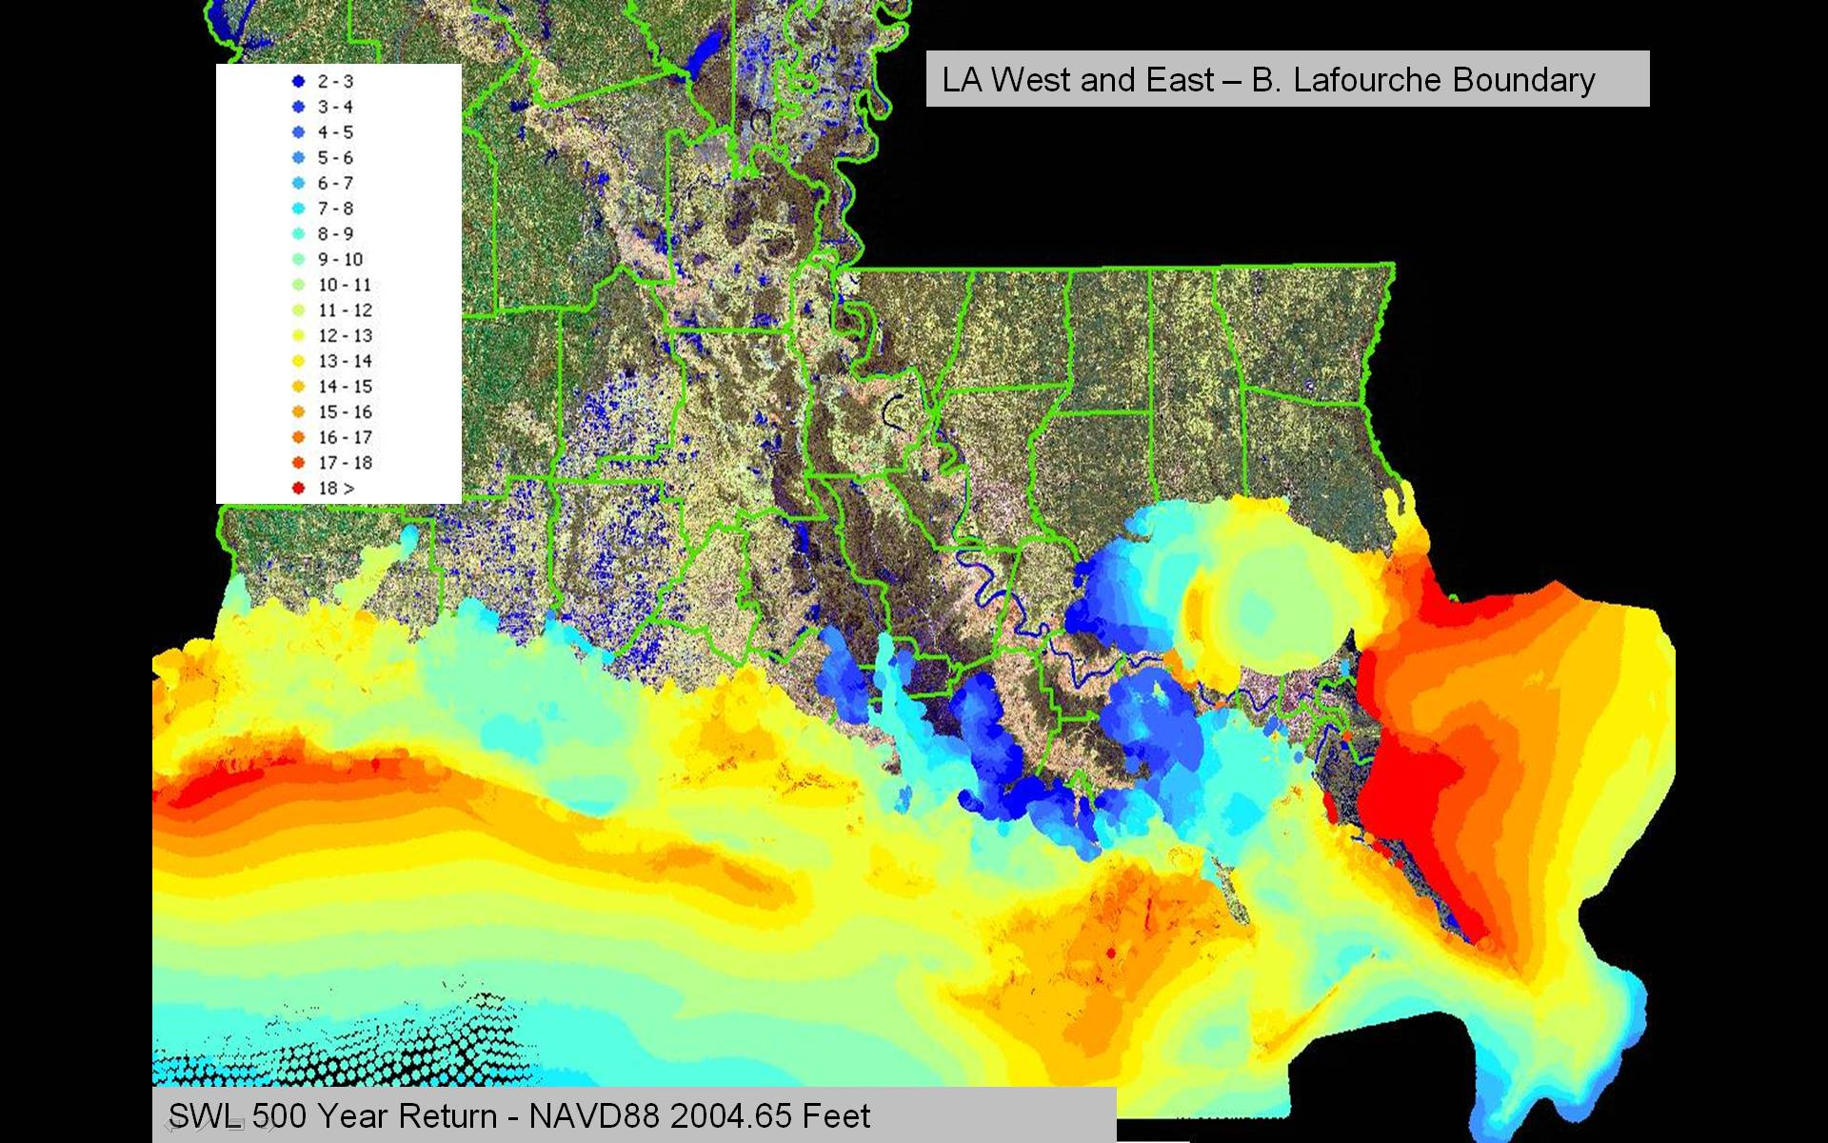
Modern Hurricane Hazard
500-year peak surge
100-year peak surge

Slide 18
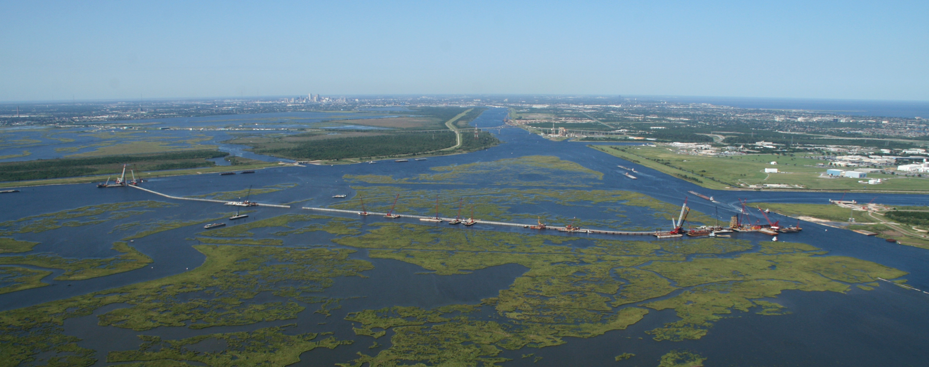
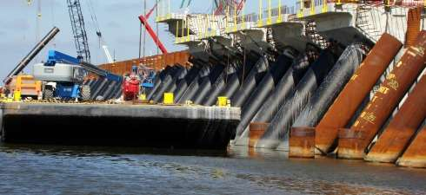
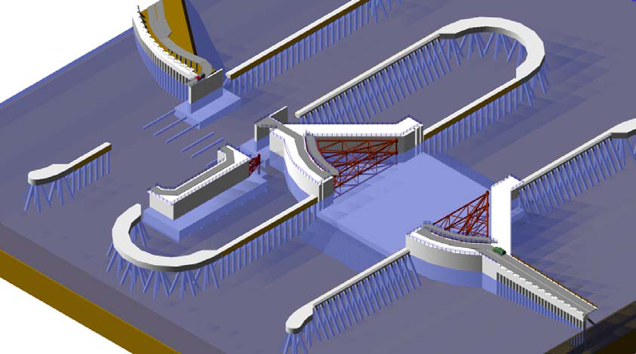
New Barrier, IHNC/GIWW
Notes:
New 1B plus navigable barrier at entrance to IHNC.

Slide 19
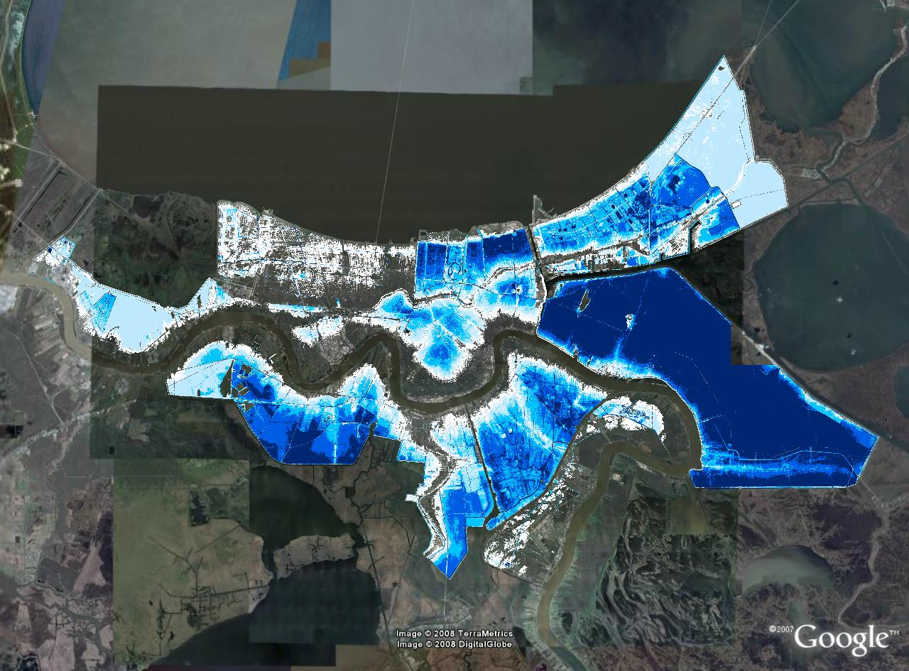
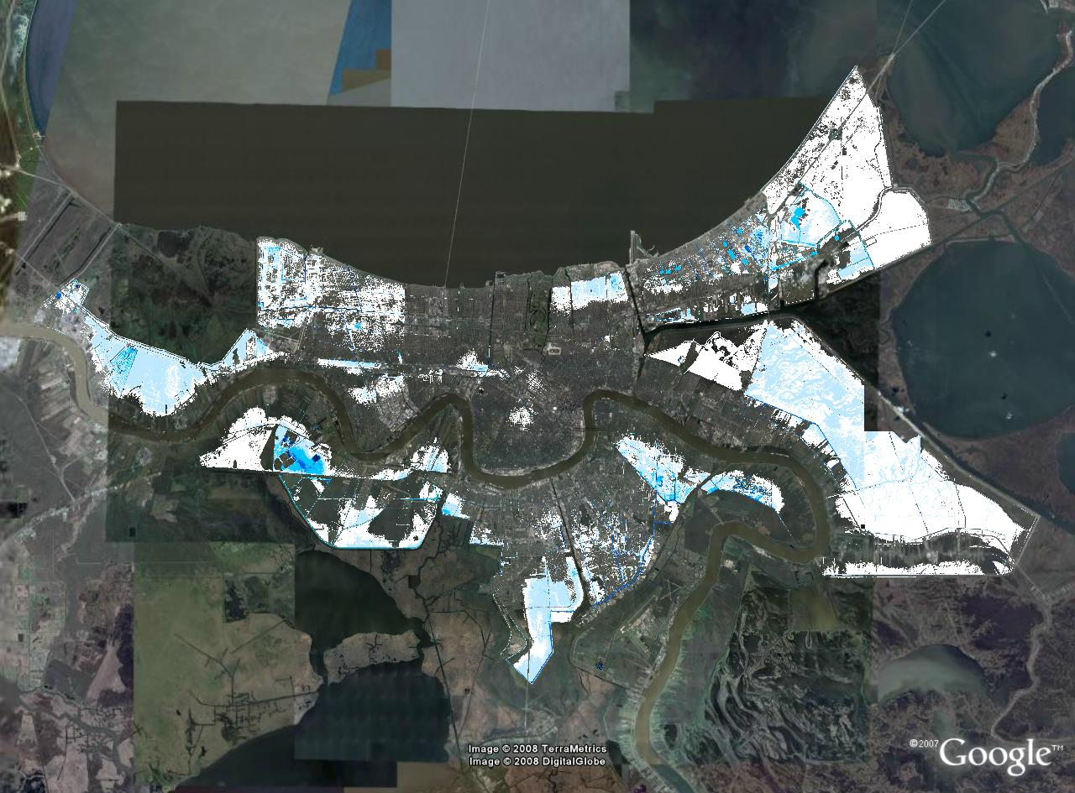
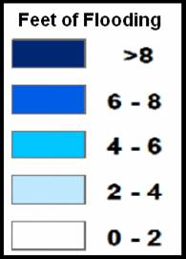
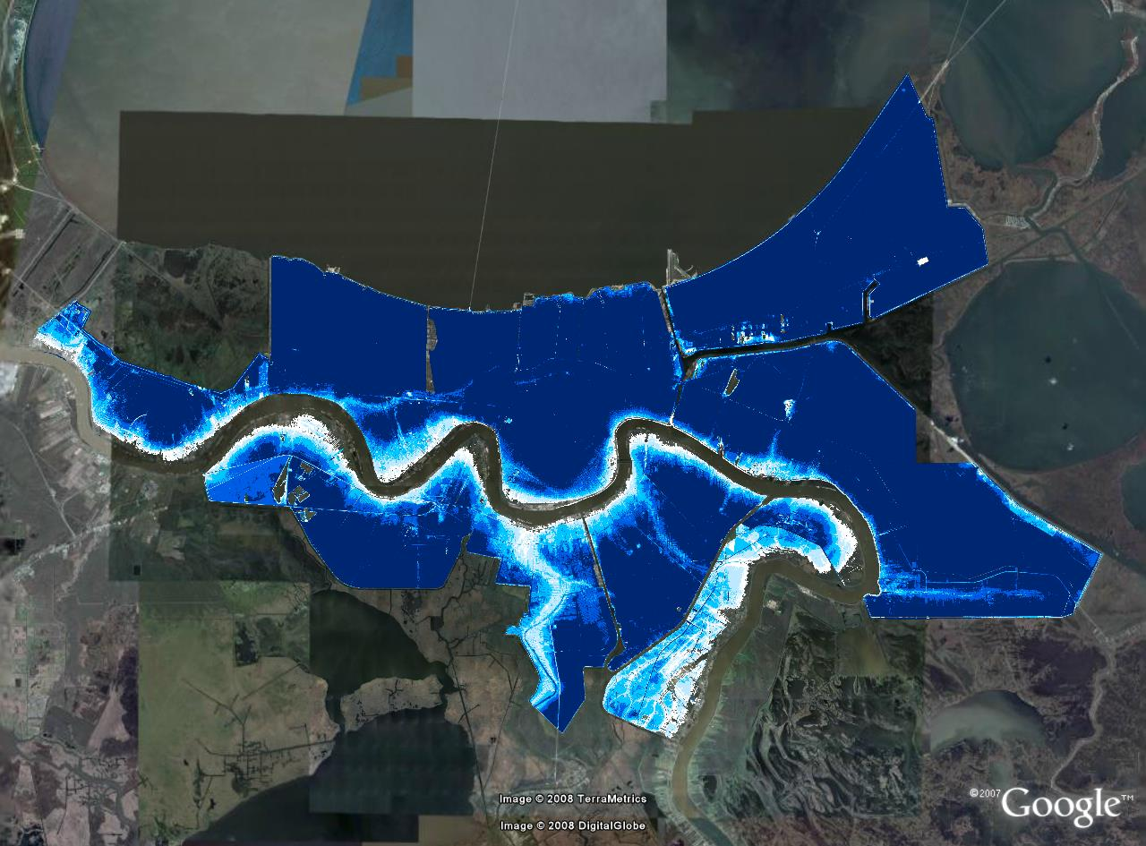
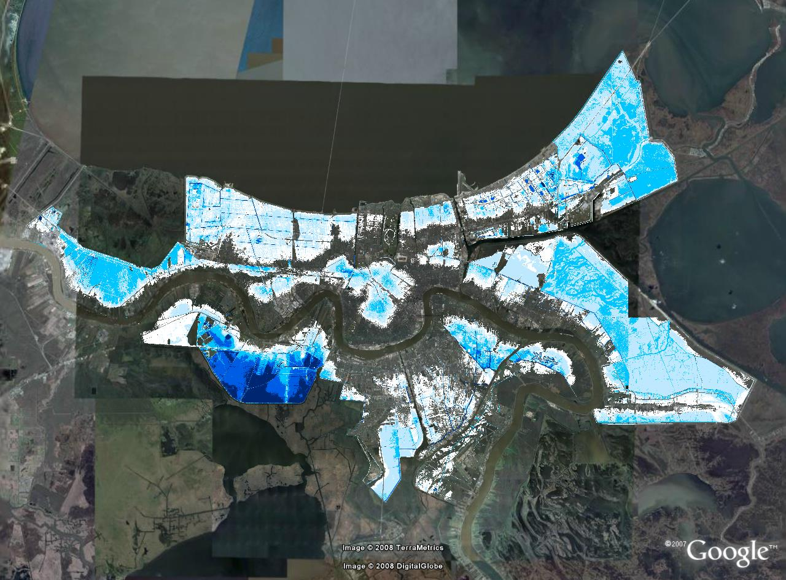
100-year vs 500-year Flood Depth Maps
100-year, W/Pumps
100-year, W/Pumps
2007, 100-year, 50% Pumps
2007, 500-year, 50% Pump
500-year, W/Pumps
500-year, W/Pumps
Pre-Katrina
2011 HSDRRS
IPET
Notes:
19

Slide 20
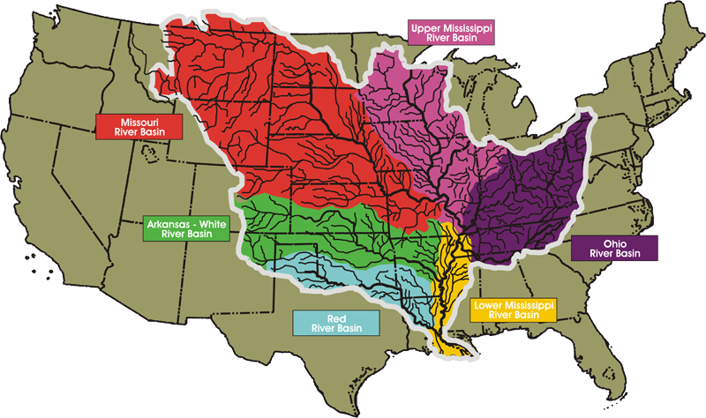
Mississippi River Basin
3.1 million km²
32% of total US farm acreage
The Mississippi Basin Drains 41% of the Contiguous United States
Missouri
Ohio
Copyright ©2011 Omaha World-Herald®.
Mississippi River
Length - 3730 km
Average flow – 12,700,000 m³/s
Max Flow -85,000 m³/s
Mississippi

Slide 21
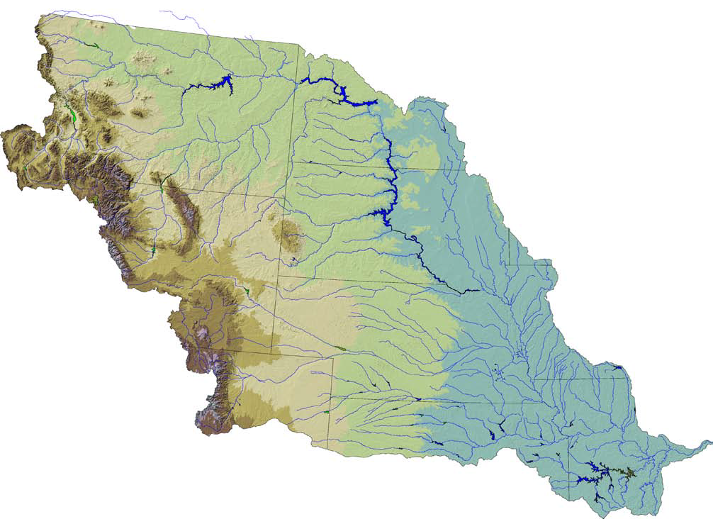
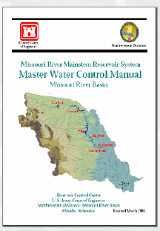
Fort Peck
Garrison
Main Stem
Reservoirs
Oahe
Big Bend
Fort Randall
Gavins Point
Levees
and
Channels
Tributary
Reservoirs

Slide 22
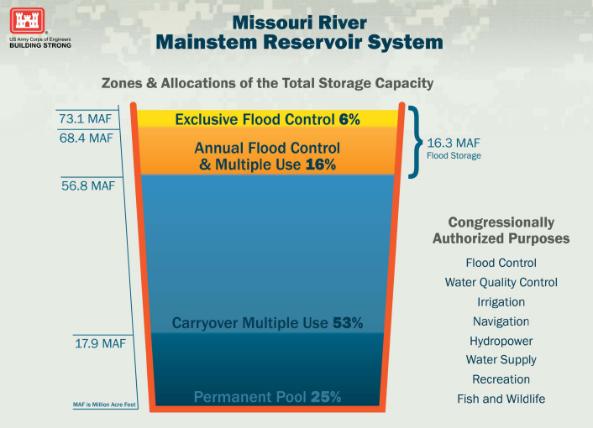
20,000 MM³

Slide 23
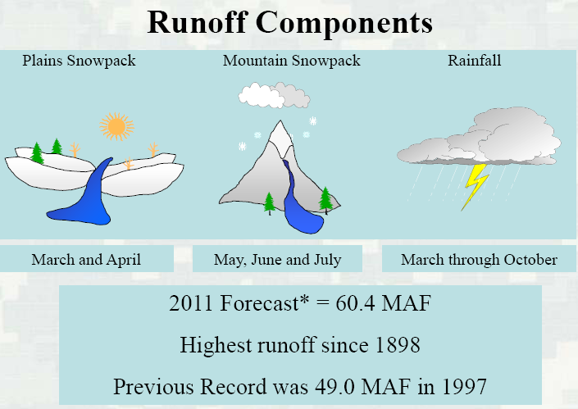
(73,800 Mm³)

Slide 24
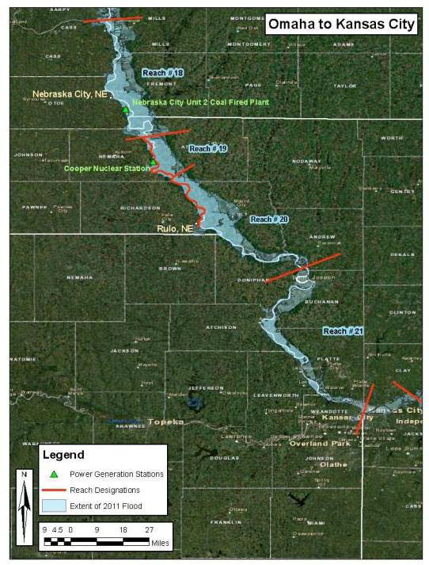
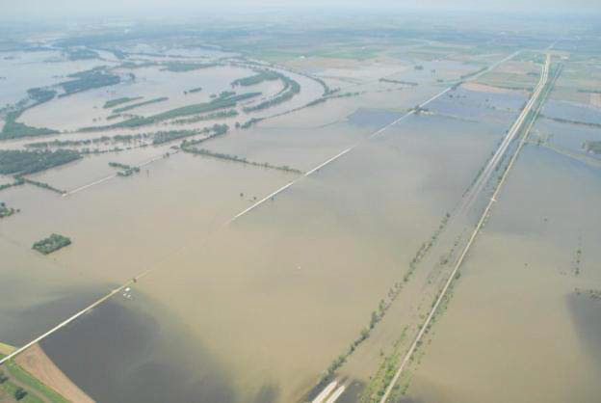
b
1881 Flood of record
1844 Flood of Record

Slide 25
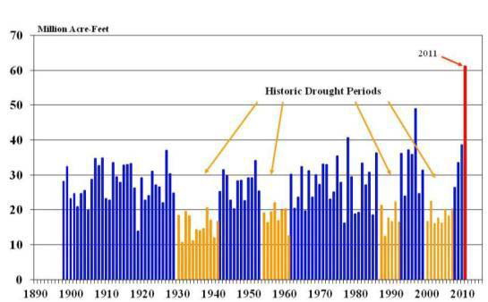
Missouri River Basin - Annual Runoff above Sioux City, Iowa
1 Maf = 1233 Mm³
.2%
.2%/97
1881 Flood = Design Criteria
1%
1%/97

Slide 26
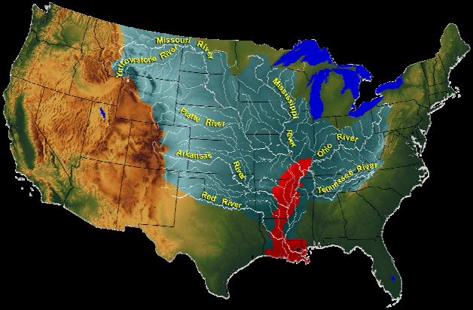
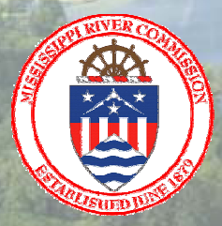

Slide 27
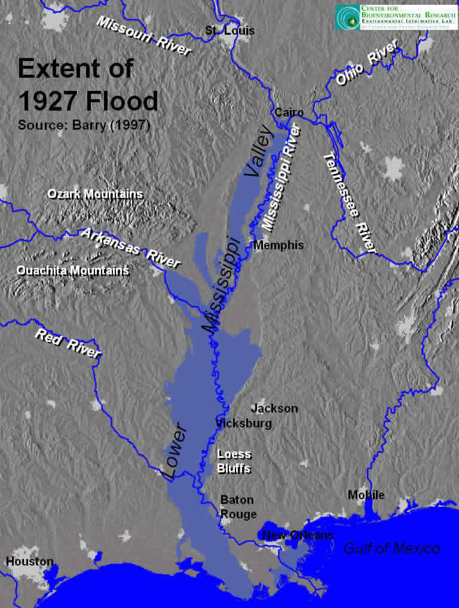
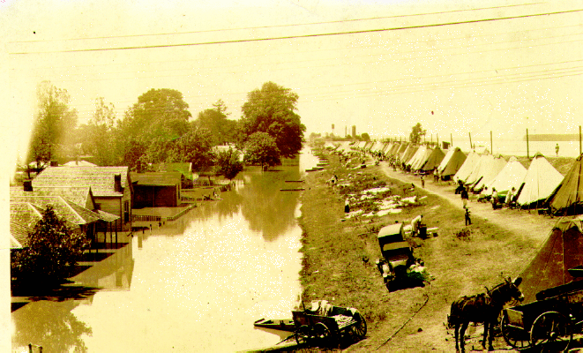

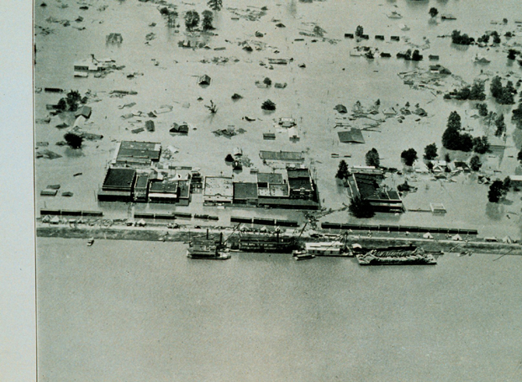

Slide 28
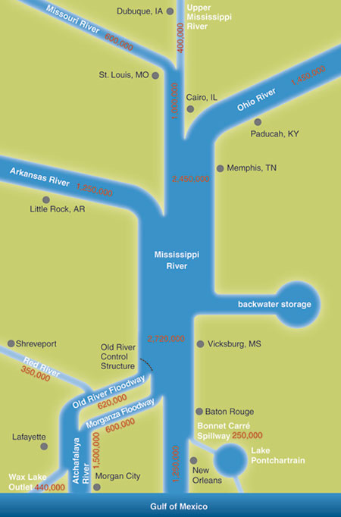

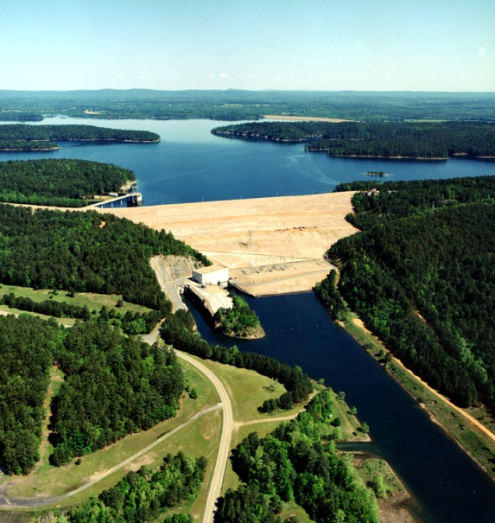
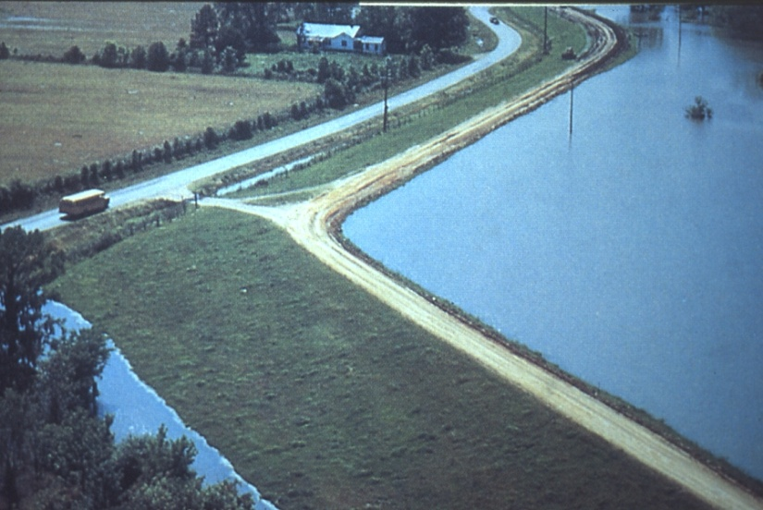
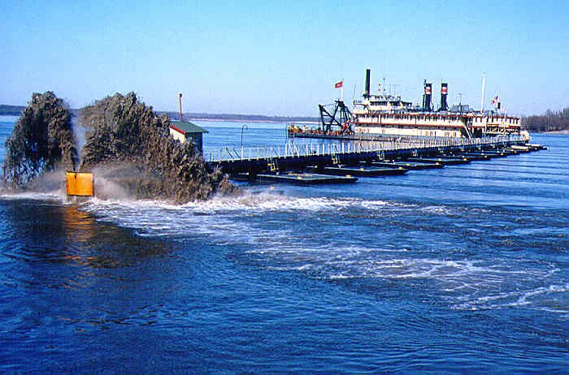
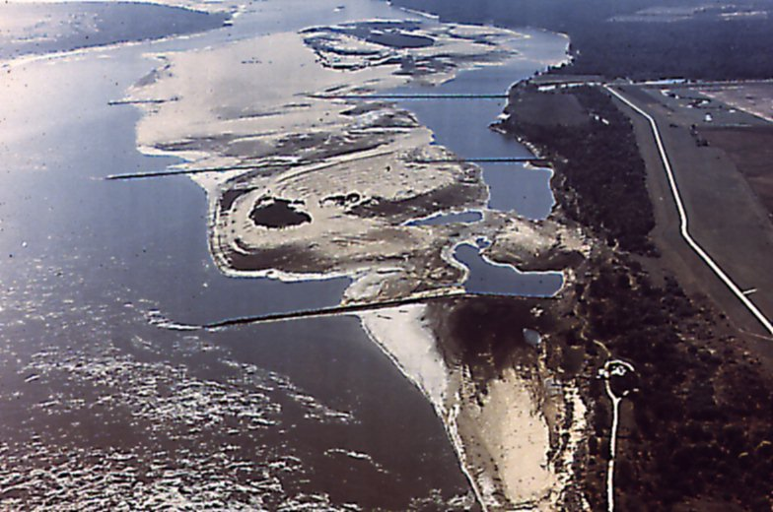
The 12 Month Solution:
Federal Project - Levees, Floodways, Storage, River training, Dredging, Dikes, Dams
Navigation, Flood Control, Environment

Slide 29
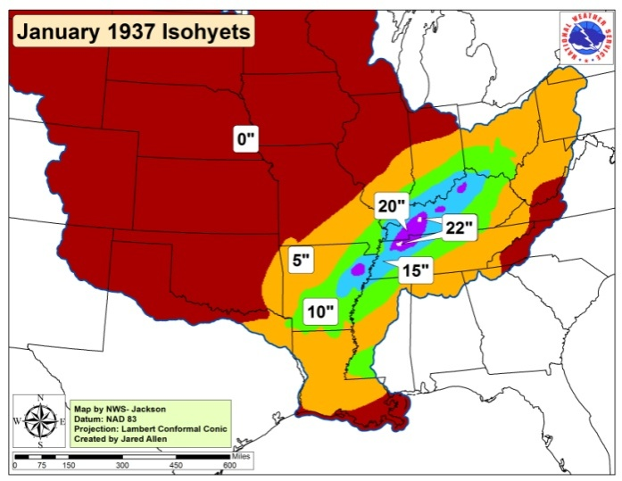
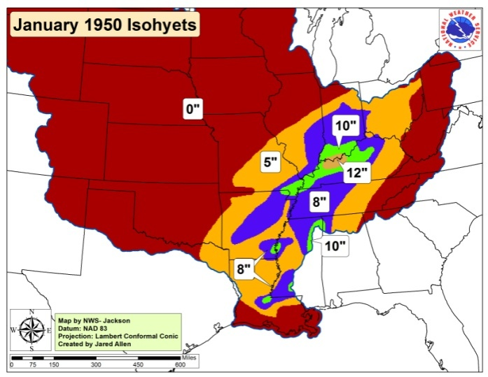
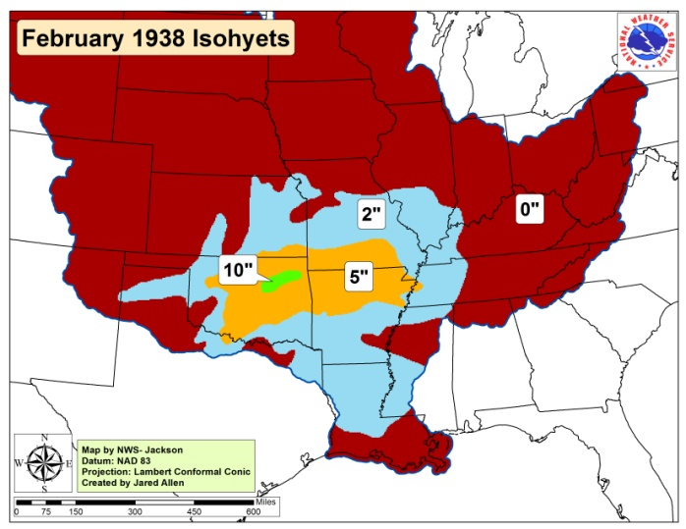
Three Storms Generate Project Design Storm
(No Snow Melt Considered)

Slide 30
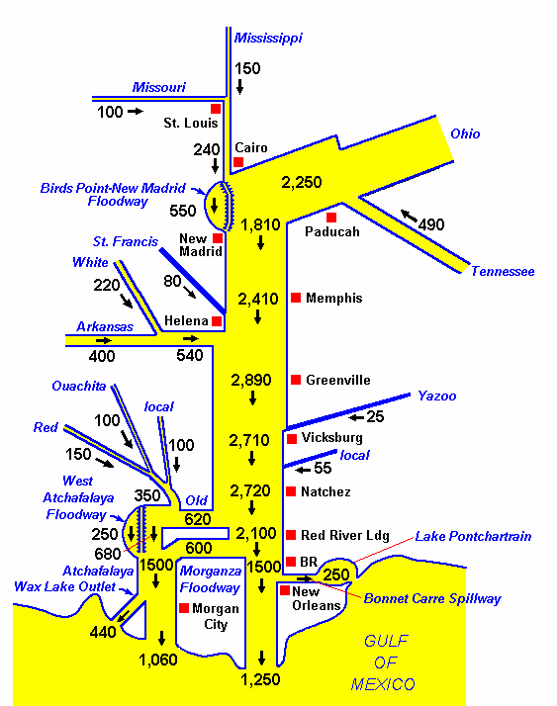
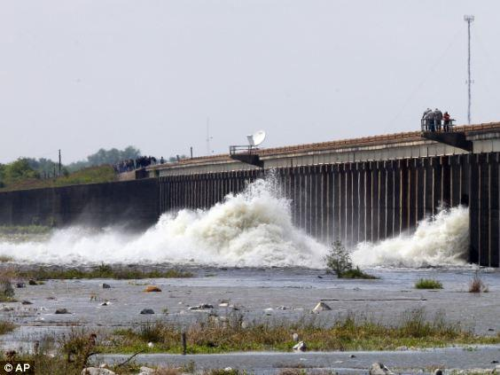
Project Design Flood
Morganza Floodway

Slide 31
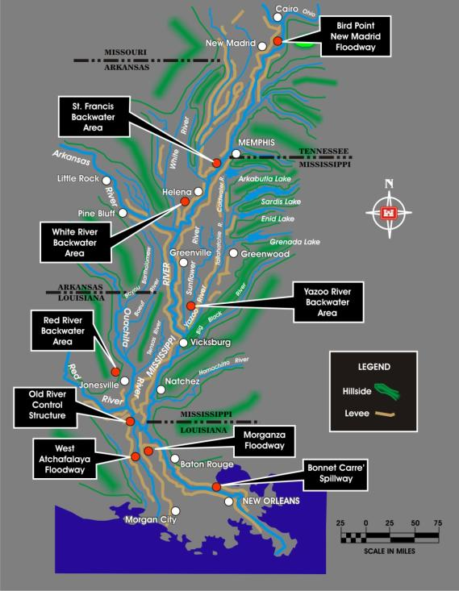
System: Reservoirs,
Levees, Floodways
and Backwater Areas
Notes:
The Birds Point-New Madrid flood is one feature of the MR&T project.
The floodway was designed to prevent the project flood from exceeding the design elevation at and above Cairo and along east bank levee adjacent to the floodway.
The floodway boundaries are defined by the main stem MR&T project levee between Birds Point, Missouri, and New Madrid, Missouri, on the east and the setback levee on the west.
The 130,000-acre area within the floodway varies in width from about three to ten miles, has a length of nearly 35 miles. The floodway is designed to divert 550,000 cfs from the Mississippi River during the project flood and provides about seven feet of stage lowering in the vicinity of Cairo, with smaller reductions above Cairo and through the floodway reach.
The floodway has two fuseplug levees at its upper and lower end. The fuseplug sections are levees constructed to a lower height than the main stem levees. The floodway is placed into operation when the fuseplug levees are artificially crevassed. Under the current operating plan developed in 1986, the floodway is activated when sections of the frontline levee naturally overtop or are artificially crevassed. The floodway requires timely operation to insure its design effect during a flood approaching the project flood magnitude. In addition to natural overtopping, the plan of operation involves the placing and detonation of explosives at critical locations.

Slide 32
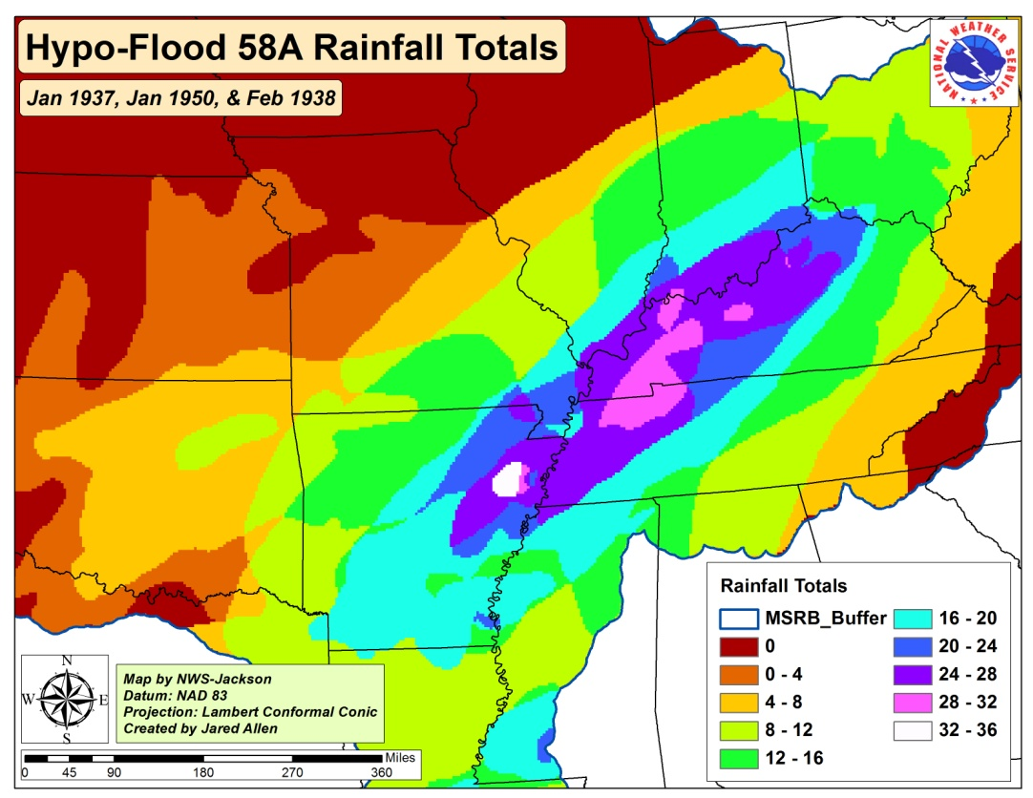
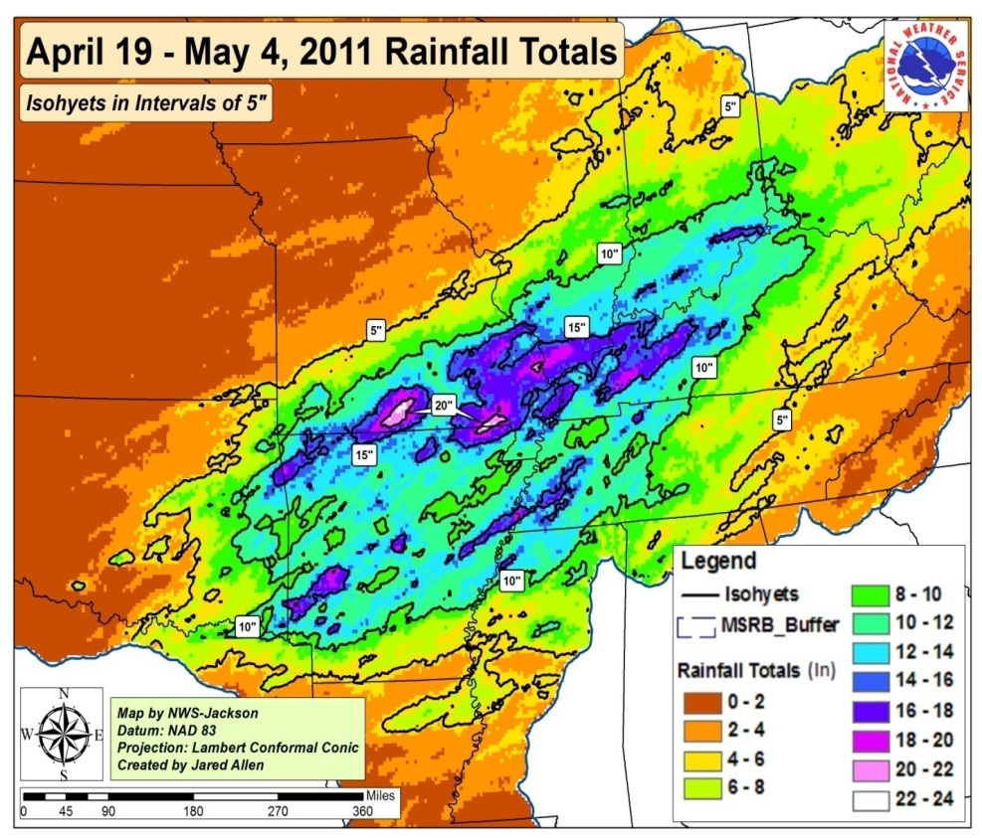
Observed Apr 19-May 4 2011
Precipitation
Total PDF Precipitation
69 % of PDF Rainfall
Plus major snow melt
PDF occurred in 3 weather events.
The 2011 event occurred during 2 rainfall events 4/19-4/28 and 5/1-5/4 plus snowmelt
Stages at Cairo were elevated (+10ft or 127% of normal) at the onset of the 2011 rainfall event

Slide 33
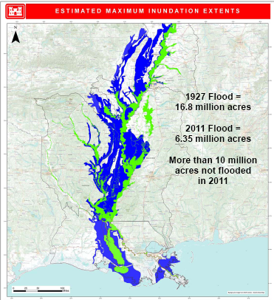
Historic High
Discharges
above NOLA
(68,000 km²)
80 % PDF Flow
(26,300 km²)
55 % Floodway
Capacity Used
(40,500 km²)
20 % Backwater
Storage Used

Slide 34
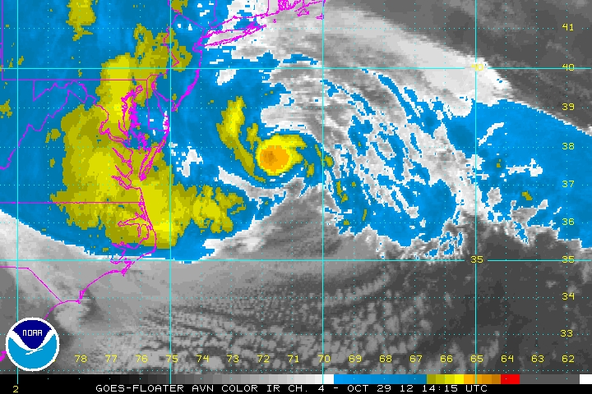
Hurricane Sandy
X

Slide 35
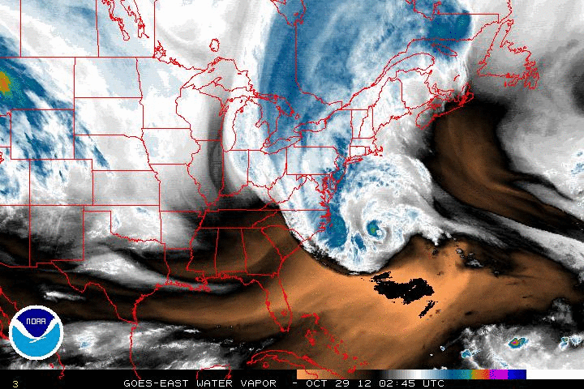

Slide 36
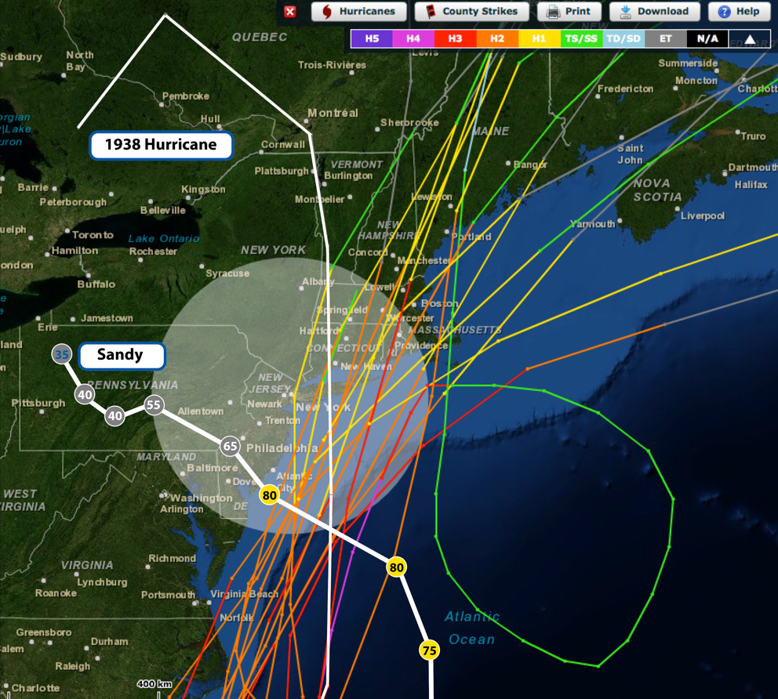

Slide 37

The Long Island Express
September 19-21, 1938
Category 5 over ocean, weakened to Category 3 by landfall
200-year hurricane
500 miles wide
Storm surge 14-18 ft
600 Fatalities
$18 B Damages

Slide 38


Slide 39


Slide 40

SANDY, Oct 2012

Slide 41


Slide 42

January 24, 2013

Slide 43


Slide 44

Ocean Gate, N.J., November 2012
Photo - FEMA

Slide 45


Slide 46
What Have We Learned Lately
Hurricane Katrina 2005
Lack of External Peer Review
Risk and Uncertainty (Societal versus Nature)
Outdated Hazard (forces)
Outdated Standards, Failure Modes
Need Complete Systems (and Resources)
Missouri/Mississippi River Flooding 2011
Conservative Criteria can counter Surprise
Multi-Purpose can Dilute Extreme Event Performance
Value of Redundancy and Robustness
Need Complete System
Challenge of using history as a basis for Design (1881/1844)
Super Storm Sandy 2012
High Cost of Lack of Anticipation and Preparedness
Rare Event
Difficulty in undoing decades of land use practice
Complexities of collaborative solutions
The need to plan and adapt long term
Perhaps the Greatest Challenges Lie Ahead

Slide 47

A new study points to the rapidly escalating risk of Sandy-magnitude flooding events in the New York City area. The study, published Thursday in the Bulletin of the American Meteorological Society, found that sea level rise has already doubled the annual probability of a Sandy-level flood in New York City since 1950.
Going Forward
Climate Change Doubles Likelihood of Sandy-Level Floods in NYC
Hurricanes Become Less Threatening To US Coast, Based On Climate Models
a new study by researchers from Columbia University and Colorado State University is suggesting climate change could eventually keep such hurricanes from making a sizeable impact on US coastlines. Publishing the findings in the journal Proceedings of the National Academy of Sciences ….

Slide 48

Current drought occurrence in the western U.S. is approaching that of the Medieval Warm Period.
Western US Drought Area Index (-1 PDSI)
80 yr lowpass
Medieval Warm Period
Percent Area of Drought (<-1 PDSI)
Little Ice Age
800
900
1000
1100
1200
1300
1400
1500
1600
1700
1800
1900
2000
Krusik & Cook (2004) North American Drought Atlas

Slide 49


Slide 50

A SEA LEVEL RISE RESPONSE STRATEGY FOR THE STATE OF MARYLAND
Zoë Pfahl Johnson
NOAA Coastal Management Fellow
for
Maryland Department of Natural Resources
Coastal Zone Management Division
October, 2000
Website: www.dnr.state.md.us

Slide 51



Slide 52


Updating Maryland’s Sea-level Rise Projections
Current Inundation
6 ft SLR Inundation
Scientific and Technical Working Group
Maryland Climate Change Commission
June 26, 2013

Slide 53

Sea Level Rise Response Strategy
Worcester County, Maryland
September 2008
Worcester County, Maryland
Department of Comprehensive Planning
1 West Market Street
Snow Hill, Maryland 21863-1249

Slide 54
What Does This Mean Going Forward?
Embracing risk and uncertainty
Continually changing standards and practice
Continuous education
Integrated systems solutions across physical and political boundaries
Adaptive life-cycle management
Just-in-time or continuous peer review

Slide 55
Philosophy
In times of change, learners inherit the Earth, while the learned find themselves beautifully equipped to deal with a world that no longer exists.
Eric Hoffer

Slide 56


