Slide 1

2013
Fall Conference
Exhibitors

Slide 2
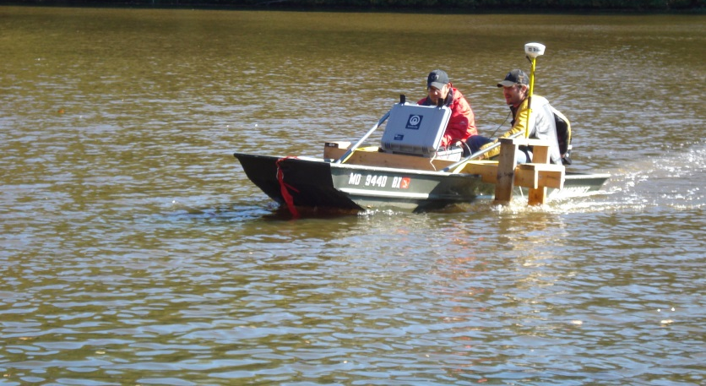
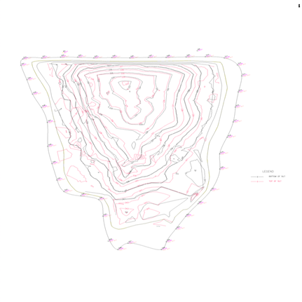
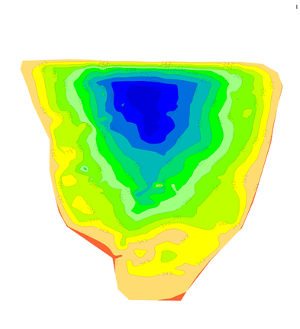

2013 Fall Conference Exhibitor
Charles P. Johnson & Associates, Inc.
Bathymetric Surveys
Utilizing dual frequency sonar transducer and real-time GPS
Uses:
Sedimentation quantities and rates
Dredging measurements
Dam Breach Studies
Verification of Water Quality volumes
Contact:
Brian Davila
Public Sector Division Manager
bdavila@cpja.com
301-434-7000
Civil and Environmental Engineers – Planners – Landscape Architects - Surveyors

Slide 3
MetroCount® traffic data specialists
2013 Fall Conference Exhibitor
Contact:
Tel: +1.800.576.5692
Cell: +1.301.233.2116
Fax: +1.301.490.3521
Patrick Corridon
Sales Team Leader - North America
pcorridon@metrocount.com

Slide 4



Located in Neenah, Wisconsin, Neenah Foundry is a supplier of municipal castings including manhole frames, lids and grates, trench castings, decorative tree grates, to name a few. Since 1872, Neenah Foundry has been a consistent leader in producing durable castings that are used across the country.
Neenah Foundry operates with a strict adherence to process standards, which assures consistent quality.
2013 Fall Conference Exhibitor
Bollards
SedCatch Inlet Protection
Detectable Warning Surfaces
Rubber Riser Rings
Adjusting Rings
Inlet Frame and Grates
Manhole Frame and Covers
Access and Hatch Covers
Contact:
Delmarva Castings & Supply
ANDY SIMMONS
asimmons@delmarvacastings.com
Ph: 800.616.1442
Fax: 410.778.5998
www.delmarvacastings.com
Neenah Foundry Co.
RICK WILSON
Maryland Sales
Rick.wilson@neenahenterprises.com
Ph: (301) 875-8565
www.nfco.com

Slide 5

2013 Fall Conference Exhibitor
Contact:
Tel. (804) 264-0707
Fax (804) 264-0219
Cell (804) 393-6609
Chuck Ingram
cingram@slurrypavers.com

Slide 6

2013 Fall Conference Exhibitor
Contact:
p. 410.749.0112 x120 (northwood)
p. 410.749.9901 (downtown)
f. 410.749.9323
Nina DiCarlo East
DiCarlo Precision Instrument
& DiCarlo Digital Copy Center
nina@dicarlo1.com

Slide 7

Manufacturer’s Representative Serving the Water/Wastewater Industry
2013 Fall Conference Exhibitor
Contact:
Mark Wehland mwehland@freemire.com
1215 Old Dorsey Road, Harmans MD 21077
P (410)768-8500 F (410)768-3400
Email: sales@freemire.com

Slide 8

2013 Fall Conference Exhibitor
Blue-Tek
Fiberglass Reinforced
Ultra-Violet Cured-In-Place-Pipe Lining
Mike Hoffmaster
Business Development Manager
Cell (240) -372-4381
mhoffmaster@pleasantsconstruction.com

Slide 9

Maryland Concrete
2013 Fall Conference Exhibitor
Contact:
P.O. Box 617
Frederick, MD 21705
office: 301-694-4899
fax: 301-694-4839
Tom Evans
MRMCA&PC
MD Chapter ACI
tom@marylandconcrete.com

Slide 10

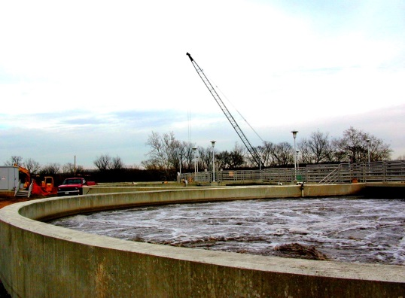
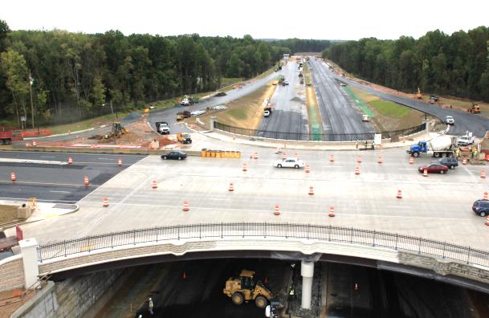
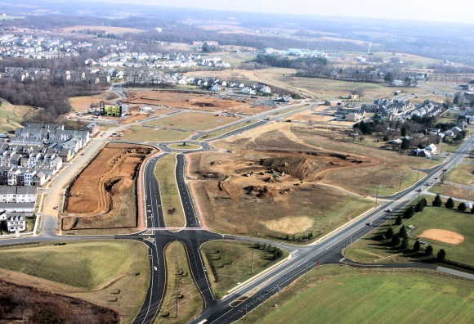
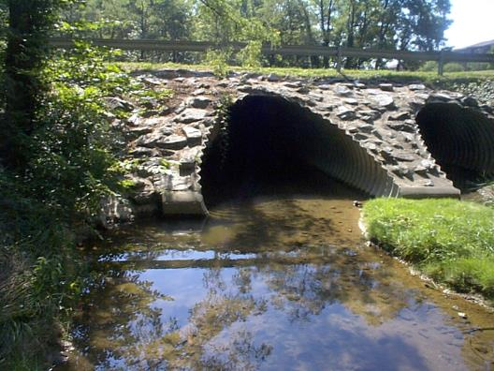
2013 Fall Conference Exhibitor
Contact:
Charles R. Mitchell, P.E. cmitchell@specializedengineering.com
or
David S. Schultz, P.E. dschultz@specializedengineering.com

Slide 11

2013 Fall Conference Exhibitor
Contact:
Wayne Cleaver
Wayne@reconconstruction.com
office: 717-779-0663
fax: 717-779-0724

Slide 12
Snap-Tite
2013 Fall Conference Exhibitor
Contact:
Joe Nagy
joe.nagy@isco-pipe.com
office: 304-224-4800
fax: 502-235-8109

Slide 13

Services BAI provides:
Solid Waste Management
Shale Gas Development
Property Reuse & Restoration
Natural Resources Management
Energy Transmission Development
Renewable Energy Development
2013 Fall Conference Exhibitor
Contact: Booth #14
Craig Marker, P.E. Jim Echard, P.E. Ed Layton, P.G.
Middletown, DE State College, PA Royersford, PA
302.449.4961 814.238.2060 610.495.5585

Slide 14

2013 Fall Conference Exhibitor
Engineering Services
Pavement / Utility / Structural / Traffic / Environmental / GIS
Construction Services
Infrastructure Asset Management Services
Pavement / Utility / Pedestrian / Maintenance / Bridge / Signs / Signals
Sustainability Studies / MAP-21 Compliance
Contact:
Greg Jakubiak
gjakubiak@kercherei.com
443-907-5056 www.kercherei.com

Slide 15


2013 Fall Conference Exhibitor
Contact:
Mike Polak Partner @ 610-636-0121
Mpolak@EJBreneman.com

Slide 16
Kim Engineering, Inc.
2013 Fall Conference Exhibitor
Contact:
Keith Brown
keith@kimengineering.com
office: 301-754-2882
fax: 301-754-2884

Slide 17
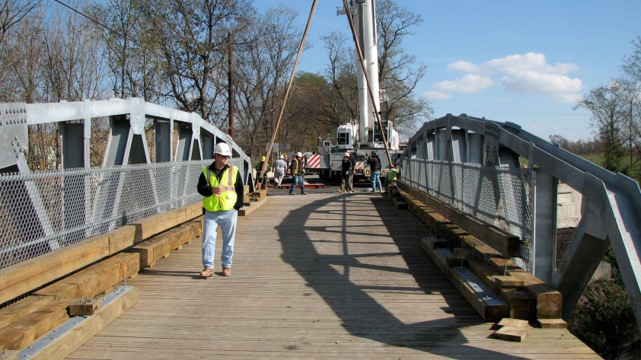
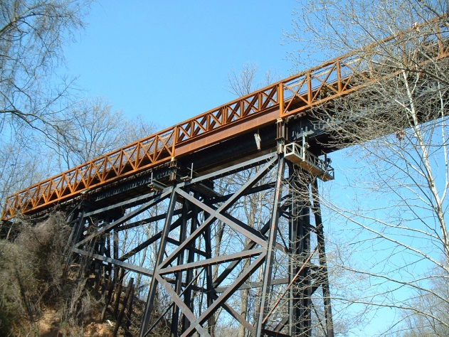
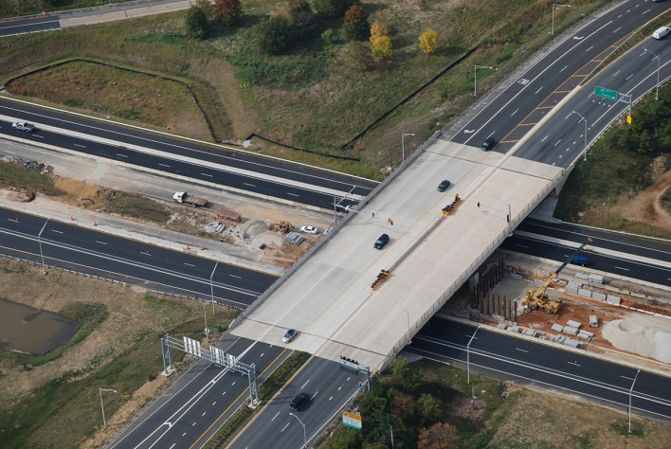
Stantec Consulting Services Inc.
2013 Fall Conference Exhibitor
Mouth of Monocacy Road
Georgetown Trestle
I-95 , Section 100
Contact:
Stantec Maryland Offices:
Baltimore
Germantown
Laurel
Simon Simon, P.E.
Senior Principal
240.542.3181 (office)
301.526.6414 (mobile)
simon.simon@stantec.com

Slide 18
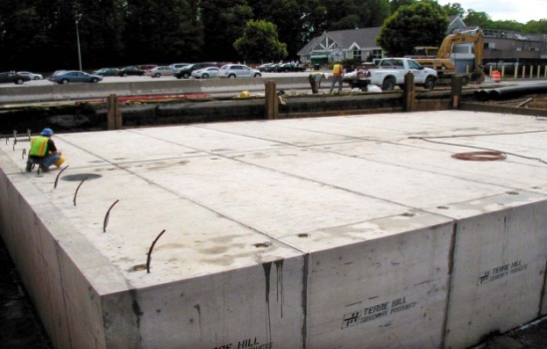
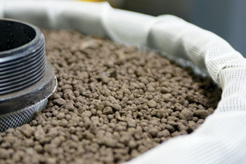
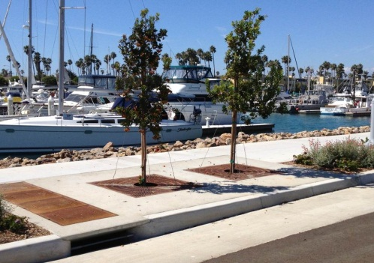
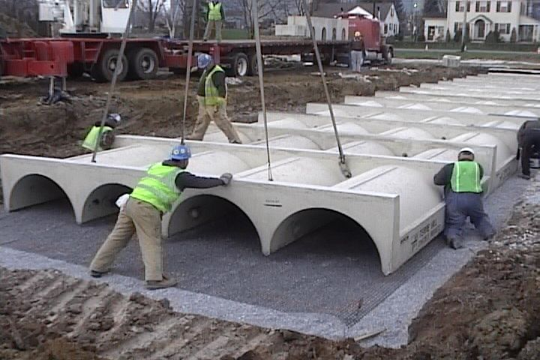

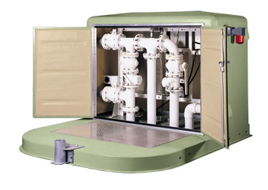


2013 Fall Conference Exhibitor
Watertight Storage Tanks
Media & Membrane Filters
BioFilter Inlets
Grit-Oil Separators
Rainwater Harvesting Systems
Infiltration Facilities
Contact:
Matt Griffin, P.E.
Stormwater Consultant
Maryland & Delaware
Mgriffin@conteches.com
office: 866.740.3318 fax: 866-376-8511

Slide 19




Federal Highway Administration (FHWA) MD State Highway Administration (SHA)
2013 Fall Conference Exhibitor
Contact:
Joris Torres • FHWA Maryland Office
Caryn Brookman • SHA

Slide 20

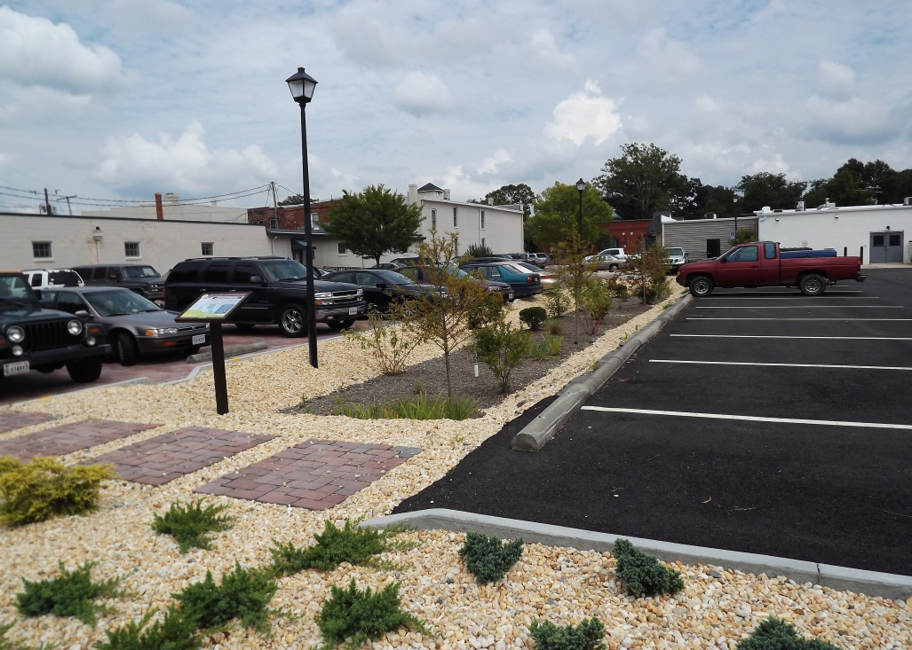
2013 Fall Conference Exhibitor
Contact:
Paul Gallant Territory Manager
pgallant@gmail.com
804-971-0401

Slide 21


University of Maryland
2013 Fall Conference Exhibitor
Contact:
Paul Easterling
peaster@umd.edu
office: 301-405-3017
fax: 301-405-3305

Slide 22
2013
Fall Conference
Exhibitors

