Slide 1

National Association of County Engineers
“The Voice of County Road Officials”

Slide 2
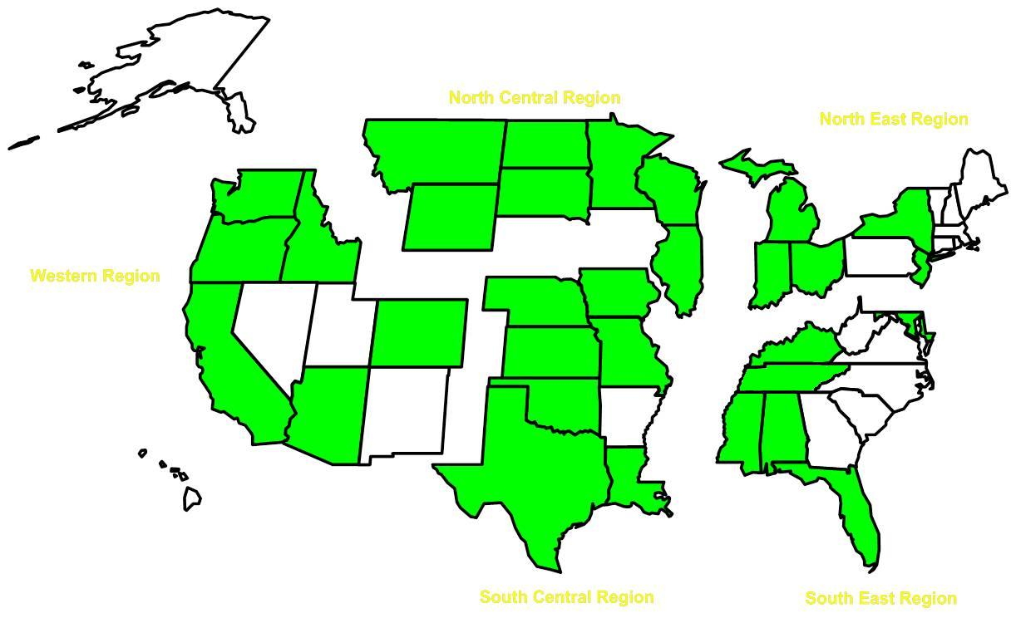
NACE Affiliates

Slide 3
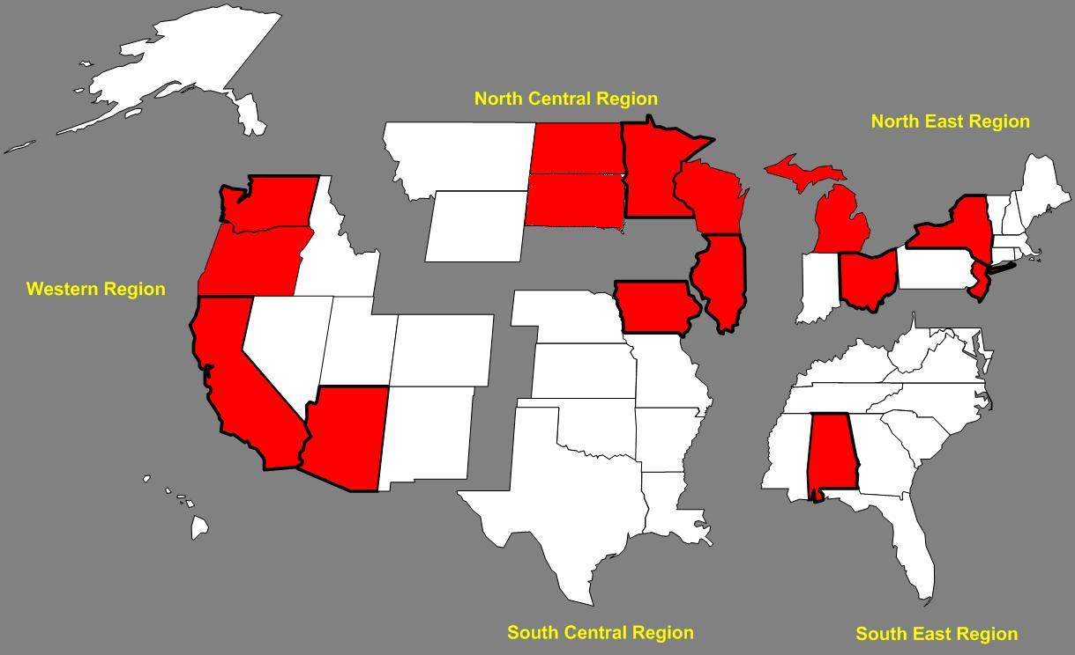
100 % Affiliates

Slide 4

New DOT Secretary Anthony Foxx
(Previous Charlotte Mayor)

Slide 5
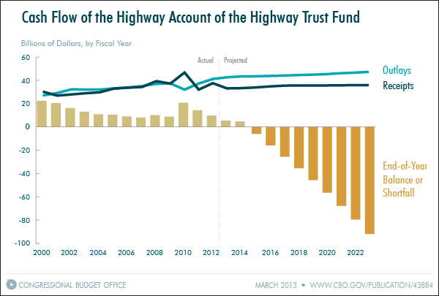
Highway Trust Fund

Slide 6
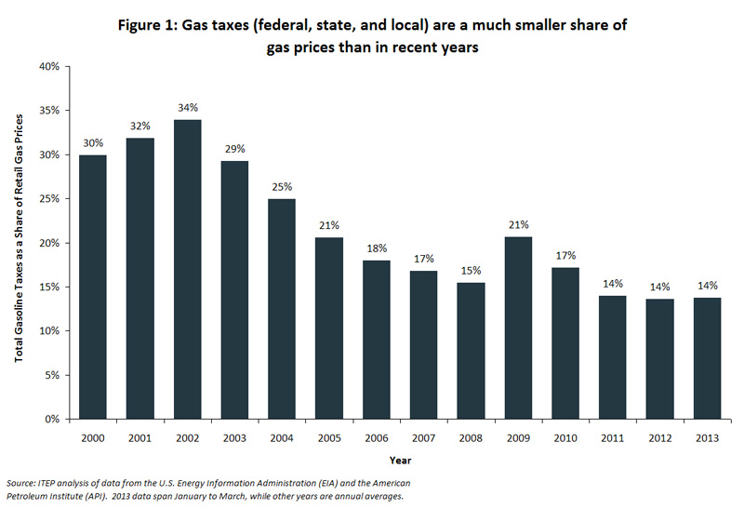

Slide 7
Focus Areas
EDC2 – LPA Initiative
MAP-21
TZD

Slide 8
Local Public Agency (LPA) EDC-II Initiatives
EDC Exchange September 24
Draft LPA Implementation Plan
Stakeholder Partnering
Certification/Qualification Program
for LPAs
Consultant Selection Strategies for Engineering Services

Slide 9
MAP-21
Off System Bridge Program
Federal Lands Access Program
  Local Representative
Safety
  Data acquisition and analysis
  Developing local safety improvement plans
Streamlining
Performance Management/Measures?
  Safety

Slide 10
Towards Zero Deaths
TZD for Counties
Adoption and Implementation by Counties

Slide 11
TZD Can be Many Things
An “Umbrella” of Safety Programs
A toolbox of strategies
A common national vision
A program to unite stakeholders
The US component of Decade of Action
A commitment to saving lives

Slide 12
Towards Zero Deaths
Adoption and Implementation by Counties
“A commitment to a comprehensive, multidisciplinary, aggressive, and proactive approach to improving highway safety”

Slide 13
Implementation
Establishment of Inter-Departmental and/or Inter-Agency work group
Review and consideration of all identified strategies
Commitment to data collection and analysis
Participate in SHSP Development
Development of Local Safety Improvement Plan
Continuing Education

Slide 14

NACE 2014 Baton Rouge
April 13-17
Notes:
NACE 2010 will be held in Fort Worth, TX at the Sheraton Hotel.

Slide 15
Key Safety Focus Areas
Safer drivers and passengers
Safer infrastructure
Safer vehicles
Safer vulnerable users
Enhanced emergency medical services (EMS)
Improved safety management and data processes

Slide 16
Improved safety management and data processes
Include the public health community and injury surveillance practices in the development, implementation, and evaluation of state, regional, and local safety plans
Improve the accuracy and completeness of crash location information
Develop and promote core competencies for all positions within transportation agencies, and ensure staff is knowledgeable regarding the state of the practice

